Slide 1
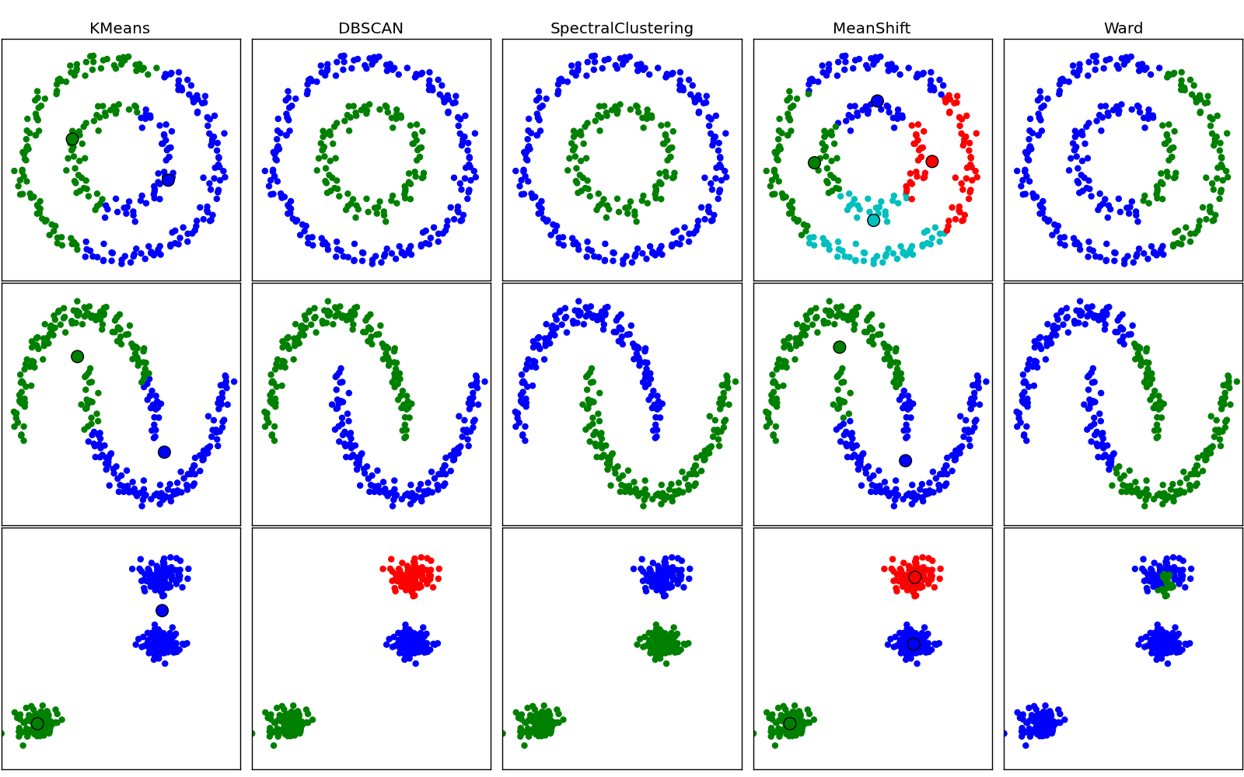
Chapter 10. Cluster Analysis: DBSCAN
Meng Jiang
CSE 40647/60647 Data Science Fall 2017
Introduction to Data Mining

Slide 2
Cluster Analysis
Cluster Analysis: An Introduction
Partitioning Methods
Density-based Methods
Evaluation of Clustering

Slide 3
Density-Based and Grid-Based Clustering Methods
Density-Based Clustering
Basic Concepts
DBSCAN: A Density-Based Clustering Algorithm
OPTICS: Ordering Points To Identify Clustering Structure
Grid-Based Clustering Methods
Basic Concepts
STING: A Statistical Information Grid Approach
CLIQUE: Grid-Based Subspace Clustering

Slide 4
Density-Based Clustering Methods
Clustering based on density (a local cluster criterion), such as density-connected points
Major features:
Discover clusters of arbitrary shape
Handle noise
One scan (only examine the local region to justify density)
Need density parameters as termination condition
Several interesting studies:
DBSCAN: Ester, et al. (KDD’96)
OPTICS: Ankerst, et al (SIGMOD’99)
DENCLUE: Hinneburg & D. Keim (KDD’98)
CLIQUE: Agrawal, et al. (SIGMOD’98) (also, grid-based)

Slide 5
DBSCAN: A Density-Based Spatial Clustering Algorithm
DBSCAN (M. Ester, H.-P. Kriegel, J. Sander, and X. Xu, KDD’96)
Discovers clusters of arbitrary shape: Density-Based Spatial Clustering of Applications with Noise
A density-based notion of cluster
A cluster is defined as a maximal set of density-connected points
Two parameters:
Eps (ε): Maximum radius of the neighborhood
MinPts: Minimum number of points in the Eps-neighborhood of a point
The Eps(ε)-neighborhood of a point q:
N_{Eps}(q): {p belongs to D | dist(p, q) ≤ Eps}
p
MinPts = 5
Eps = 1 cm
q
Outlier
Outlier/noise: not in a cluster
Border
Core point: dense neighborhood
Core
Border point: in cluster but neighborhood is not dense

Slide 6
DBSCAN: Density-Reachable and Density-Connected
Directly density-reachable:
A point p is directly density-reachable from a point q w.r.t. Eps (ε), MinPts if
p belongs to N_{Eps}(q)
core point condition: |N_{Eps} (q)| ≥ MinPts
Density-reachable:
A point p is density-reachable from a point q w.r.t. Eps, MinPts if there is a chain of points p₁, …, p_{n}, p₁ = q, p_{n} = p such that p_{i+1} is directly density-reachable from p_{i}
Density-connected:
A point p is density-connected to a point q w.r.t. Eps, MinPts if there is a point o such that both p and q are density-reachable from o w.r.t. Eps and MinPts
p
MinPts = 5
Eps = 1 cm
q
p
p₂
q
p
q
o

Slide 7
DBSCAN: The Algorithm
Algorithm
Arbitrarily select a point p
Retrieve all points density-reachable
from p w.r.t. Eps and MinPts
If p is a core point, a cluster is formed
If p is a border point, no points are density-reachable from p, and DBSCAN visits the next point of the database
Continue the process until all of the points have been processed
Outlier
Outlier/noise: not in a cluster
Border
Core point: dense neighborhood
Core
Border point: in cluster but neighborhood is not dense

Slide 8
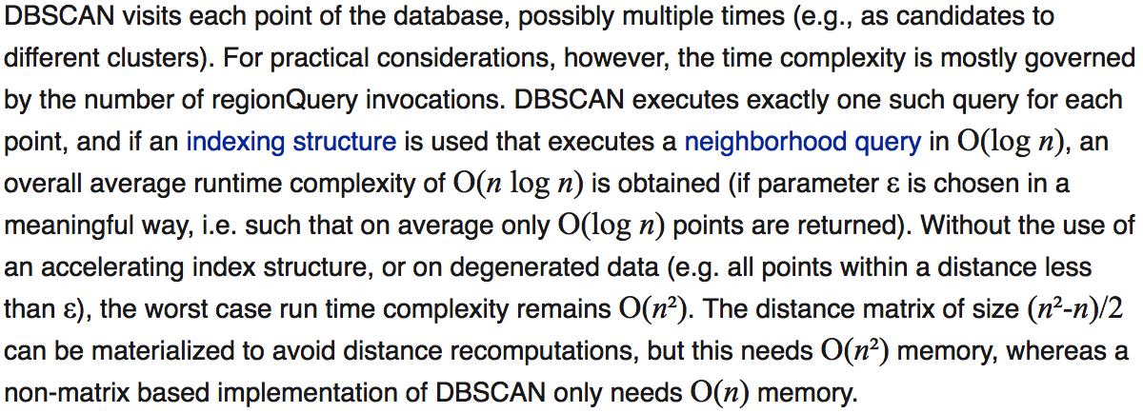
DBSCAN: The Algorithm
Computational complexity
If a spatial index is used, the computational complexity of DBSCAN is O(nlogn), where n is the number of database objects
Otherwise, the complexity is O(n²)
https://en.wikipedia.org/wiki/DBSCAN

Slide 9
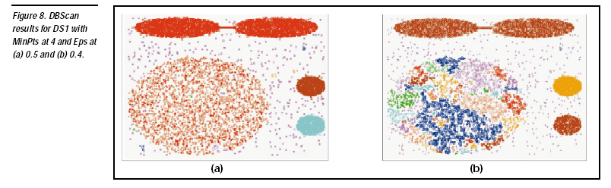
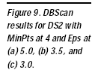
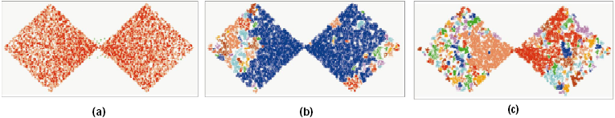
DBSCAN Is Sensitive to the Setting of Parameters
Ack. Figures from G. Karypis, E.-H. Han, and V. Kumar, COMPUTER, 32(8), 1999

Slide 10
References: (III) Density-based Methods
M. Ester, H.-P. Kriegel, J. Sander, and X. Xu. A Density-Based Algorithm for Discovering Clusters in Large Spatial Databases. KDD'96
W. Wang, J. Yang, R. Muntz, STING: A Statistical Information Grid Approach to Spatial Data Mining, VLDB’97
R. Agrawal, J. Gehrke, D. Gunopulos, and P. Raghavan. Automatic Subspace Clustering of High Dimensional Data for Data Mining Applications. SIGMOD’98
A. Hinneburg and D. A. Keim. An Efficient Approach to Clustering in Large Multimedia Databases with Noise. KDD’98
M. Ankerst, M. M. Breunig, H.-P. Kriegel, and J. Sander. Optics: Ordering Points to Identify the Clustering Structure. SIGMOD’99
M. Ester. Density-Based Clustering. In (Chapter 5) Aggarwal and Reddy (eds.), Data Clustering: Algorithms and Applications . CRC Press. 2014
W. Cheng, W. Wang, and S. Batista. Grid-based Clustering. In (Chapter 6) Aggarwal and Reddy (eds.), Data Clustering: Algorithms and Applications. CRC Press. 2014

Slide 11
A General Suspiciousness Metric for Dense Blocks in Multimodal Data
Meng Jiang
Joint work with
Alex Beutel, Peng Cui, Bryan Hooi,
Shiqiang Yang, Christos Faloutsos

Slide 12
Suppose You Work in Twitter
My boss wants me to
catch fraud in such a big table – billions of records, tens of columns!!! How?!
fraud
Notes:
Let me tell you our motivation. Suppose you work in Twitter, because you love big data, and Twitter has big data,
Your boss gives you the data. He wants you to find what is worth inspecting, which could be fraudulent messages, or promotional information.
But the data table is too big. It may have billions of records and also tens of columns.
It has user information, Johnson and Thompson, time information, and text information including hashtag, URL and many other information.
So this big data has multiple modes.

Slide 13
Massive Multi-Modal Data: Lines (Mass) & Columns (Mode)
Dataset | Mode |  |  |  | Mass
Retweeting | User | Root ID | IP | Time (min) | #retweet
 | 29.5M | 19.8M | 27.8M | 56.9K | 211.7M
Trending (Hashtag) | User | Hashtag | IP | Time (min) | #tweet
 | 81.2M | 1.6M | 47.7M | 56.9K | 276.9M
Network attacks (LBNL) | Src-IP | Dest-IP | Port | Time (sec) | #packet
 | 2,345 | 2,355 | 6,055 | 3,610 | 230,836
Notes:
Let’s take a look at the multi-modal data we have. Retweet hijacking and trend manipulating.

Slide 14

Suspicious Behaviors in Multi-Modal Data
Notes:
We have seen lots of IT news about the companies who have monetary incentives,
working at some locations, with a group of IP addresses/machines, manipulating their fake Twitter accounts.
They inject suspicious behaviors into the dataset. Their messages are often social fraud.

Slide 15


Dense Blocks Indicates Suspiciousness
200 minutes
time
225
user
27,313
Notes:
We find that the injected suspicious behaviors create dense blocks. Suppose we can observe the user and time modes. An example for a dense block is we spot…

Slide 16
Dense Blocks Indicates Suspiciousness
120 minutes
time
user
40
IP
12,375
2
Notes:
What if we have another mode of information, say, IP address? Now we have 3-mode data and a 3-mode block. See we spot…

Slide 17
Dense Blocks Indicates Suspiciousness
120 minutes
time
+Hashtag
+URL
+Product
+Location
+…
user
40
IP
12,375
2
Notes:
Twitter can collect lots of signals. We may have more modes, such as, … Different types or strategies of the social fraud may create density in different modes. For example, the fraudsters may use similar hashtags, or they use similar URLs.

Slide 18
Dense Blocks Indicates Suspiciousness
200 minutes
120 minutes
time
time
user
225
user
40
IP
12,375
2
27,313
Question: Which is more suspicious?
We need a metric to evaluate the suspiciousness.
Notes:
The problem is given us these two blocks of different modes, which is more suspicious? For the dense blocks, before we search them, we should be able to evaluate their suspiciousness. So we need a metric.

Slide 19
Metric Criteria
What properties are required of a good metric?
N₁ ⨉ N₂ ⨉ N₃
Count data with total “mass” C
f(
)
f(
n’₁ ⨉ n’₂ ⨉ n’₃
mass c’
density ρ’
)
n₁ ⨉ n₂ ⨉ n₃
mass c
density ρ
vs
Notes:
Suppose there is a metric function f. The parameters are … size/volume, mass, or density of both data and a block. Mass, for example, could be the number of messages. To compare these two suspiciousness values of the two blocks, what properties…?

Slide 20
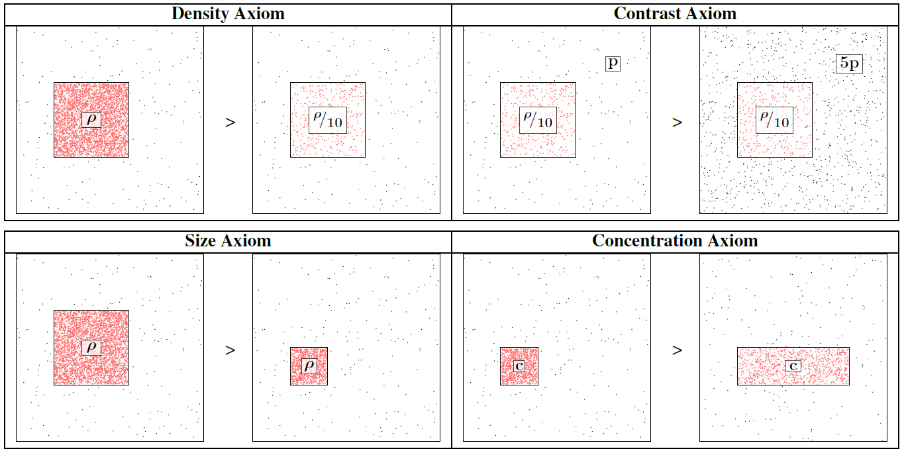
Axioms 1-4
Notes:
Density: with the same size, if a block is denser, it’s’ more suspicious.
Contract: with the same block, the data is sparser, the block…
Size: with the same density, if the block is bigger, it’s…
Concentration: with the same count, the block is smaller, it’s…

Slide 21
Axiom 5: Multimodal
Not including a mode is the same as
including all values for that mode.
=
▶ New information (more modes) can only
make our blocks more suspicious
Notes:
Not including a mode should equal with including all values for that mode.
So, …

Slide 22
Our Principled Idea: Scoring Suspiciousness
200 minutes
120 minutes
time
time
user
225
user
40
IP
12,375
2
27,313
Notes:
It is challenging to give a score function to evaluate dense blocks in multi-modal data, because the score function or the metric should satisfy all the five axioms. Let’s take three seconds to think of one. One, two, three… See, it’s hard, right? We used three weeks to find the metric and prove its properties, three months to do the experiments. It’s hard to solve this problem in three seconds.

Slide 23
Our Principled Idea: Scoring Suspiciousness
200 minutes
120 minutes
time
time
user
225
user
40
IP
12,375
2
27,313
Probability
0.9%
0.05%
Notes:
If I told you the probability of their occurrence?

Slide 24
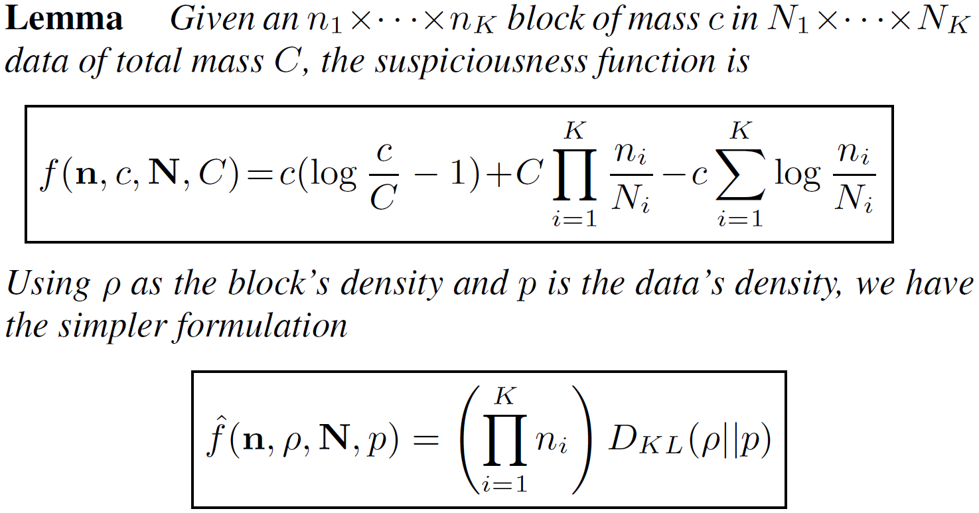
A General Suspiciousness Metric
Negative log likelihood of block’s probability

Slide 25
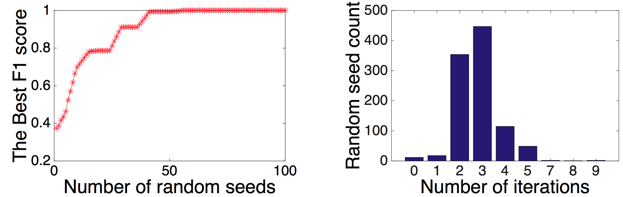
CrossSpot: Local Search with the Metric
Seed block, adjust modes, select a mode, adjust values in mode, until convergence.
Seed selection: HOSVD, or with LockInfer [PAKDD’14]
Fast convergence
Parallelize to multiple machines: Scalable!

Slide 26
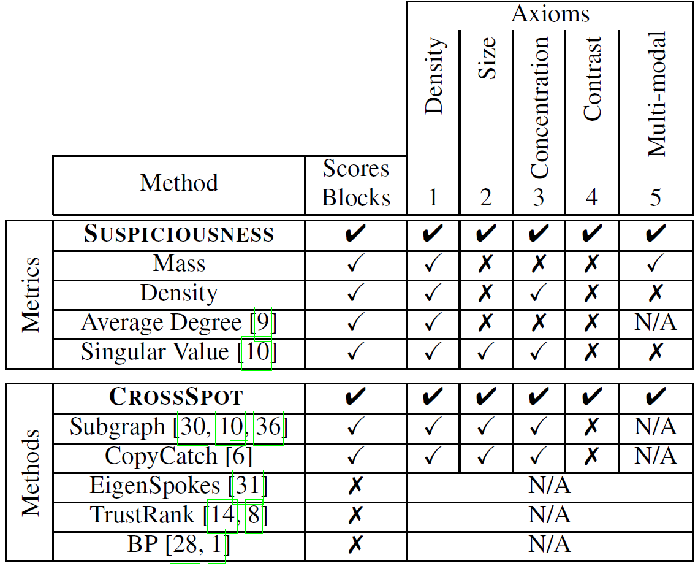
Advantage: “Suspiciousness” and CrossSpot
Score dense blocks
Target multi-modal data
Satisfy all the axioms

Slide 27
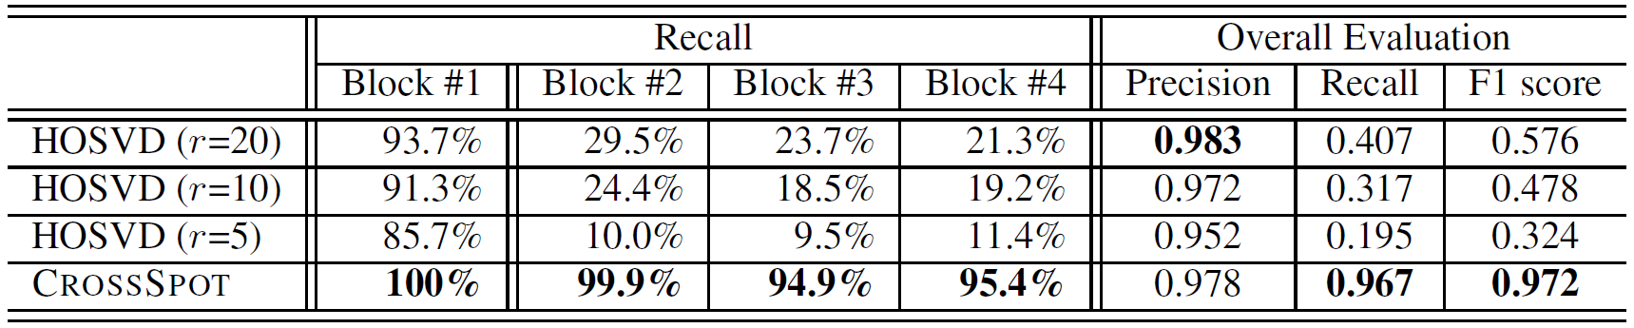
Performance: Synthetic Data
Experiments: Synthetic data
1,000×1,000×1,000 of 10,000 random data
Block#1: 30×30×30 of 512 3 modes
Block#2: 30×30×1,000 of 512 2 modes
Block#3: 30×1,000×30 of 512 2 modes
Block#4: 1,000×30×30 of 512 2 modes

Slide 28
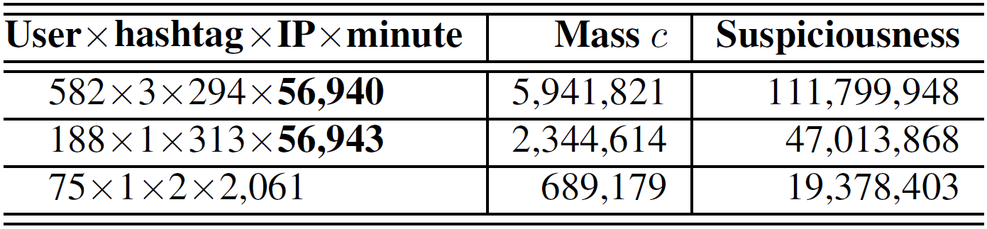
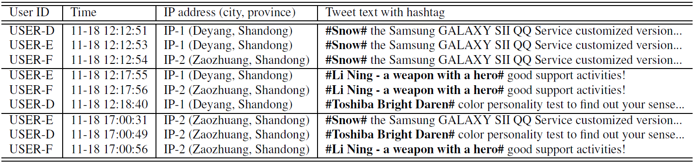
Performance: Manipulating Trends

Slide 29
Performance: Network Blocks
Notes:
These subsets of events take all the values in time mode, forming 3-mode dense blocks in 4-mode data. The cross- mode results indicate that a group of source IP addresses continuously send packets to multiple destination servers with the same group of ports in every second of one hour.

Slide 30
Conclusion
Proposed a general “suspiciousness” metric based on probability for multi-modal behaviors
CrossSpot: Proposed a local search algorithm for catching suspicious behaviors

